Slide 1

Lecture 01: Digital System Design
Dept. of Computer Sc. and Engg.
University of Rajshahi
www.ru.ac.bd
Dr. Mahboob Qaosar &
Dr. Shamim Ahmad

Slide 2
Number Systems
Decimal (Base 10)
10 digits (0,1,2,3,4,5,6,7,8,9)
Binary (Base 2)
2 digits (0,1)
Digits are often called bits (binary digits)
Hexadecimal (Base 16)
16 digits (0-9,A,B,C,D,E,F)
Often referred to as Hex

Slide 3
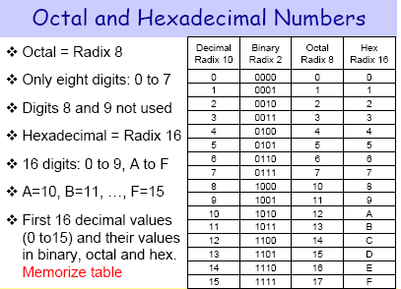
Number Systems

Slide 4
Positional Notation
Each digit is weighted by the base(r) to the positional power
N = d_{n-1}d_{n-2} …d₀.d₁d₂…d_{m}
= (d_{n-1}x r ^{n-1} ) + (d_{n-2}x r ^{n-1} ) + … + (d₀ ₁x r⁰ ) +
(d₁x r¹) + (d₂ x r²) + … (d_{m} x r ^{m} )
Example : 872.64₁₀
(8 x 10²) + (7 x 10¹) + (2 x 10⁰)
+ (6 x 10⁻¹) + (4 x 10⁻²)
Example: 1011.1₂ = ?
Example :12A₁₆ = ?

Slide 5
Positional Notation (Solutions to Example Problems)
872.64₁₀ = 8x10² + 7x10¹ + 2x10⁰ + 6x10⁻¹ + 4 x10⁻²
800 + 70 + 2 + .6 + .04

Slide 6
Positional Notation (Solutions to Example Problems)
1011.1₂
= 1x2³ + 0x2² + 1x2¹ + 1x2⁰ + 1x2⁻¹
= 8 + 0 + 2 + 1 + .5
= 11.5₁₀

Slide 7
Positional Notation (Solutions to Example Problems)
12A₁₆ = 1x16² + 2x16¹ + Ax16⁰
= 256 + 32 + 10
= 298₁₀

Slide 8
Powers of Bases
2⁻³= .125
2⁻²= .25
2⁻¹= .5 16⁰ = 1
2⁰ = 1 16¹ = 16 = 2⁴
2¹ = 2 16² = 256 = 2⁸
2² = 4 16³ = 4096 = 2¹²
2³ = 8
2⁴ = 16
2⁵ = 32
2⁶ = 64
2⁷ = 128
2⁸ = 256 2¹⁰ = 1024 = 1Kb
2⁹ = 512 2²⁰ = 1,048,576 = 1Mb
2¹⁰ = 1024 2³⁰ = 1,073,741,824 = 1Gb
2¹¹ = 2048
2¹² = 4096

Slide 9
Determining What Base is being Used
Subscripts
874₁₀ 1011₂ AB9₁₆
AB9₍₁₆₎
Prefix Symbols
(None) 874 %1011 $AB9
Postfix Symbols
AB9H

Slide 10
Conversion from Base R to Decimal
Use Positional Notation
%11011011 = ?₁₀
$3A94 = ?₁₀

Slide 11
Conversion from Binary to Decimal
Use Positional Notation
%11011011 = ?₁₀ %11011011
= 1x2⁷ + 1x2⁶ + 1x2⁴ + 1x2³ + 1x2¹ + 1x2⁰ = 128 + 64 + 16 + 8 + 2 + 1 = 219₁₀

Slide 12
Conversion from Hexadecimal to Decimal
3A94₁₆ = ?₁₀
3A94₁₆ = 3x16³ + Ax16² + 9x16¹ + 4x16⁰
=12288 + 2560 + 144 + 4
=15996

Slide 13
Conversion from Decimal to Base R
Use Successive Division
Repeatedly divide by the desired base until 0 is reached
Save the remainders as the final answer
The first remainder is the LSB (least significant bit); the last remainder is the MSB (Most significant bit)
437₁₀ = ?₂
= 110110101₂
437₁₀ = ?₁₆
= 1B5₁₆

Slide 14
Conversion from Decimal to Binary
Use Successive Division
Repeatedly divide by the desired base until 0 is reached
Save the remainders as the final answer
The first remainder is the LSB (least significant bit); the last remainder is the MSB (Most significant bit)
437₁₀ = ?₂
437 / 2 = 218 remainder 1
218 / 2 = 109 remainder 0
109 / 2 = 54 remainder 1
54 / 2 = 27 remainder 0
27 / 2 = 13 remainder 1
13 / 2 = 6 remainder 1
6 / 2 = 3 remainder 0
3 / 2 = 1 remainder 1
1 / 2 = 0 remainder 1
= 110110101₂

Slide 15
Conversion from Decimal to Hexadecimal
437₁₀ = ?₁₆
437 / 16 = 27 remainder 5
27 / 16 = 1 remainder 11 (11=B)
1 / 16 = 0 remainder 1
427₁₀ = 1B5₁₆

Slide 16
Conversion from Binary to Hex
Starting at the LSB working left, group the bits by 4s. Padding of 0s can occur on the most significant group.
Convert each group of 4 into the equivalent HEX value.
%1101110101100 = $?
= $1BAC

Slide 17
Conversion from Hex to Binary
Convert each HEX digit to the equivalent 4-bit binary grouping.
$A73 = %?
= %101001110011

Slide 18
Conversion of Fractions
Conversion from decimal to binary requires multiplying by the desired base (2)
0.625₁₀ = ?₂
= 0.101 ₂

Slide 19
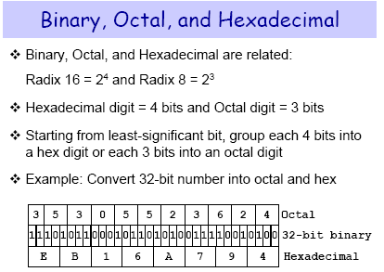

Slide 20
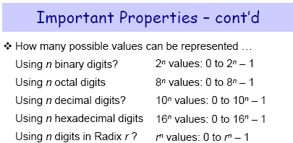

Slide 21
Addition/Subtraction of Binary Numbers
101011
+ 1
101100
101011
+ 001011
110110
The carry out has a weight equal to the base (in this case 16). The digit that left is the excess (Base – sum).

Slide 22
Addition/Subtraction of Hex Numbers
$3A
+$28
$62
The carry out has a weight equal to the base (in this case 16). The digit that left is the excess (Base – sum).

Slide 23
Signed Number Representation
Three ways to represent signed numbers
Sign-Magnitude
1s Complement
2s Complement

Slide 24
Sign-Magnitude
For an N-bit word, the most significant bit is the sign bit; the remaining bits represent the magnitude
0110 = +6
1110 = -6
Addition/subtraction of numbers can result in overflow (errors) – (Due to fixed number of bits); two values for zero
Range for n bits: -(2^{n-1}–1) through (2^{n-1}–1)

Slide 25
1’s Complement
Negative numbers = N’ = (2^{n-1}–1) –P (where P is the magnitude of the number)
For a 5-bit system, -7 = 11111 -00111
11000
Range for n bits:-(2^{n-1}–1) through (2^{n-1}–1)

Slide 26
2’s Complement
Negative Numbers = N* = 2^{n} – P
(where P is the magnitude of the number)
For a 5-bit system, -7 = 100000
-00111
11001
Another way to form 2’s complement representation is to complement P and add 1
Range for n bits: -(2^{n-1}) through (2^{n-1}–1)

Slide 27
Numbers Represented with 4-bit Fixed Digit Representation

Slide 28
Summary of Signed Number Representations
Sign Magnitude – has two values for 0
- errors in addition of negative and positive numbers
1s complement – two values for 0
- additional hardware needed to compensate for this
2s Complement – representation of choice

Slide 29
Unsigned/Signed Overflow
You can detect unsigned overflow if there is a carryout of the MSB.
You can detect signed overflow if the sum of two positive numbers is a negative number or if the sum of two negative numbers is a positive number. An overflow never occurs in an addition of a negative and a positive number.

Slide 30
Codes
Decimal Codes
BCD (Binary Coded Decimal)
Weighted Codes (8421, 2421, etc…)
ASCII Codes
ASCII (American Standard Code for Information Interchange)
Unicode Standard
Unit Distance Codes
Gray
Error Detection Codes
Parity Bit
Error Correction Codes
Hamming Code

Slide 31
BCD Codes (Decimal Codes)
Coded Representations for the 10 decimal digits
Requires 4 bits (2³ < 10 <2⁴)
Only use 10 combinations of 16 possible combinations

Slide 32
BCD Codes (Decimal Codes)
Weighted Code
8421 code
Most common
Default
The corresponding decimal digit is determined by adding the weights associated with the 1s in the code group.
The BCD representation is NOT the binary equivalent of the decimal number
623₁₀ = 0110 0010 0011
2421, 5421, etc… codes
The weights associated with the bits in each code group are given by the name of the code

Slide 33
BCD Codes (Decimal Codes)
Nonweighted Codes
2-out-of-5
Actually weighted 74210 except for the digit 0
Used by the post office for scanning bar codes for zip codes
Has error detection properties

Slide 34
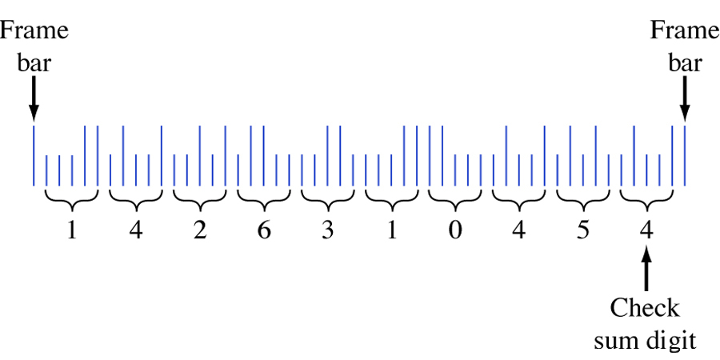
BCD Codes (Decimal Codes)
U.S. Postal Service bar code corresponding to the ZIP code 14263-1045.

Slide 35
Unit Distance Codes
Important when converting analog to digital
Only one bit changes between successive integers
Gray Code is most popular example

Slide 36
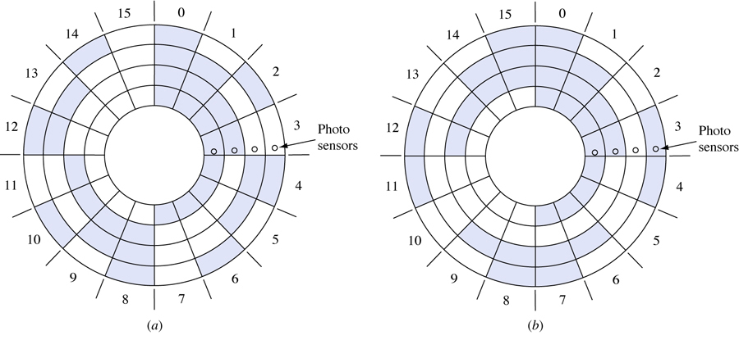
Unit Distance Codes
Angular position encoders.
Conventional binary encoder. (b) Gray code encoder.

Slide 37
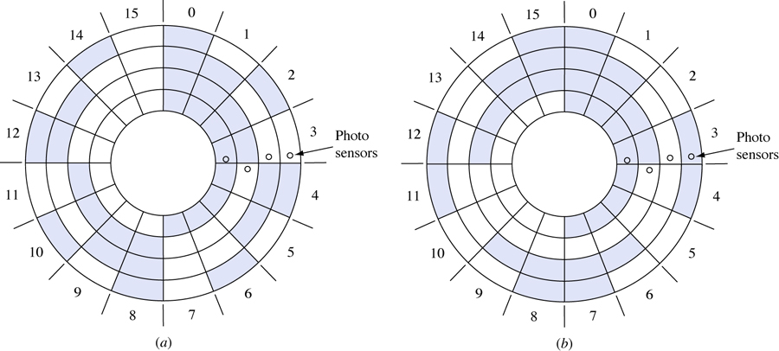
Unit Distance Codes
Angular position encoders with misaligned photosensing devices.
(a) Conventional binary encoder. (b) Gray code encoder.

Slide 38
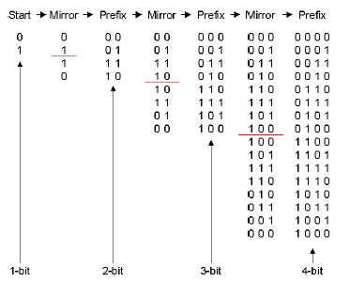
Mirror Image Conversion

Slide 39
From Binary to a Gray-code
Copy MSB
Add this bit to the next position
Record Sum
Ignore Carry (if any)
Record successive sum until completed

Slide 40
From Binary to Gray code
1 0 1 1
1 1 1 0

Slide 41
From a Gray-code to Binary
Copy MSB
Add the Binary MSB to next Significant bit of Gray code
Record Sum
Ignore Carry (if any)
Continue process until LSB is reached

Slide 42
From a Gray-code to Binary
1 0 1 1
1 1 0 1

Slide 43
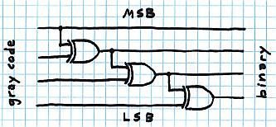
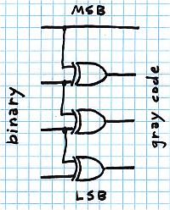
Digital Circuit

Slide 44
Excess-3 code
Decimal
Binary
Decimal
Binary
Decimal
Binary
Decimal
Binary
−3
0000
1
0100
5
1000
9
1100
−2
0001
2
0101
6
1001
10
1101
−1
0010
3
0110
7
1010
11
1110
0
0011
4
0111
8
1011
12
1111
Within the range when 1’s complemented, apart from BCD

Slide 45
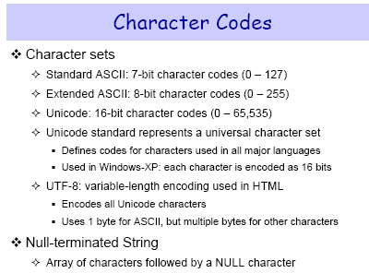

Slide 46
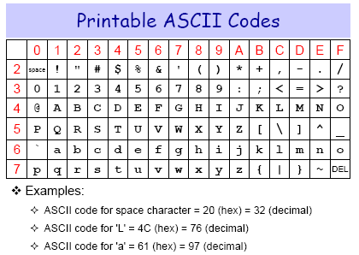
ASCII Codes

Slide 47
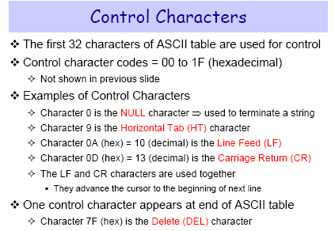

Slide 48
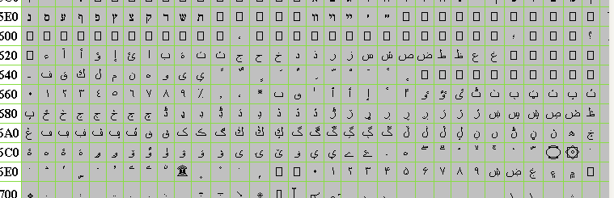
Unicode (Arabic)

Slide 49
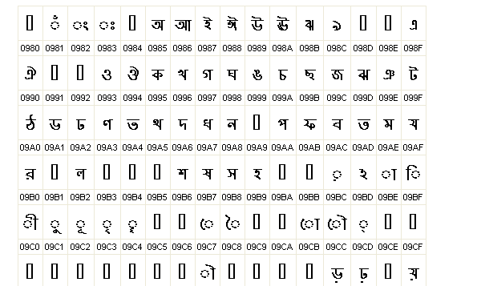
Unicode (Bengali)

Slide 50
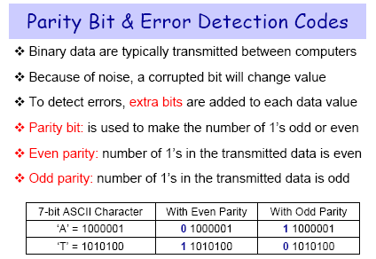

Slide 51
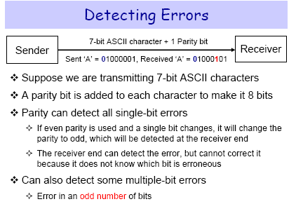

Slide 52
Hamming Code
Number the bits starting from 1: bit 1, 2, 3, 4, 5, etc.
Write the bit numbers in binary. 1, 10, 11, 100, 101, etc.
All bit positions that are powers of two (have only one 1 bit in the binary form of their position) are parity bits.
All other bit positions, with two or more 1 bits in the binary form of their position, are data bits.
Each data bit is included in a unique set of 2 or more parity bits, as determined by the binary form of its bit position.
In general each parity bit covers all bits where the binary AND of the parity position and the bit position is non-zero.

Slide 53
Hamming Code
Parity bit 1 covers all bit positions which have the least significant bit set: bit 1 (the parity bit itself), 3, 5, 7, 9, etc.
Parity bit 2 covers all bit positions which have the second least significant bit set: bit 2 (the parity bit itself), 3, 6, 7, 10, 11, etc.
Parity bit 4 covers all bit positions which have the third least significant bit set: bits 4–7, 12–15, 20–23, etc.
Parity bit 8 covers all bit positions which have the fourth least significant bit set: bits 8–15, 24–31, 40–47, etc.

Slide 54
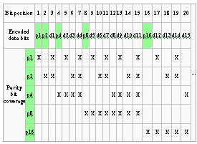
Example

Slide 55
Example
p₁
p₂
d₁
p₃
d₂
d₃
d₄
p₄
d₅
d₆
d₇
Data word (without parity):
0
1
1
0
1
0
1
p₁
1
0
1
0
1
1
p₂
0
0
1
0
0
1
p₃
0
1
1
0
p₄
0
1
0
1
Data word (with parity):
1
0
0
0
1
1
0
0
1
0
1
Calculation of Hamming code parity bits

Slide 56
Example
The new data word (with parity bits) is now "10001100101".
We now assume the final bit gets corrupted and turned from 1 to 0.
Our new data word is "10001100100";
How the Hamming codes were created we flag each parity bit as 1 when the even parity check fails.

Slide 57
Example
p₁
p₂
d₁
p₃
d₂
d₃
d₄
p₄
d₅
d₆
d₇
Parity check
Parity bit
Received data word:
1
0
0
0
1
1
0
0
1
0
0
p₁
1
0
1
0
1
0
Fail
1
p₂
0
0
1
0
0
0
Fail
1
p₃
0
1
1
0
Pass
0
p₄
0
1
0
0
Fail
1
Checking of parity bits (switched bit highlighted)

Slide 58
Example
The final step is to evaluate the value of the parity bits
It goes furthest to the right
The integer value of the parity bits is 11, signifying that the 11th bit in the data word (including parity bits) is wrong and needs to be flipped.

Slide 59
Example
p₄
p₃
p₂
p₁
Binary
1
0
1
1
Decimal
8
2
1
Σ = 11
Flipping the 11th bit changes 10001100100 back into 10001100101.
Removing the Hamming codes gives the original data word of 0110101.

Slide 60
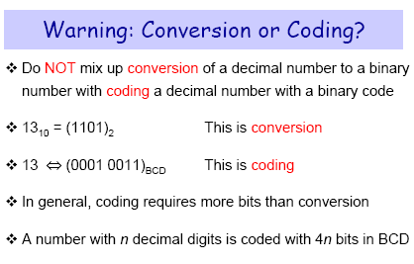

Slide 61
How Much Memory?
Memory is purchased in bits –
How many bits do I need if I want to distinguish between 8 colors?
How many bits do I need if I want to represent 16 million different colors?

Slide 62
How Much Memory?
How many bits do I need if I want to distinguish between 8 colors?
2^{x-1} < 8 <= 2^{x}
x = 3 (3 bits are needed)
How many bits do I need if I want to represent 16 million different colors?
2^{x-1} < 16 million <= 2^{x}
16M = 1Mx16 = 2²⁰x2⁴ = 2²⁴
x = 24 (24 bits are needed)

